Slide 1



PROJECT-4
PANDEMIC PULSE
NAME: SAKSHI
USN: 21BTRCL088
SECTION: AIML-B

Slide 2
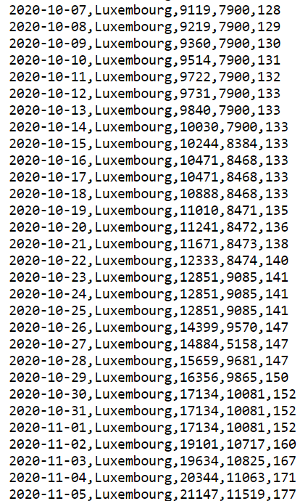
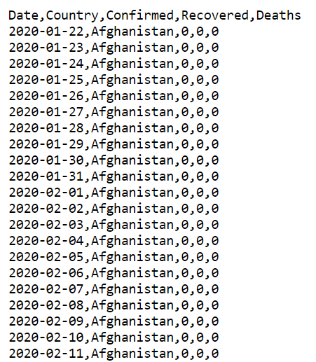
DATASET

Slide 3
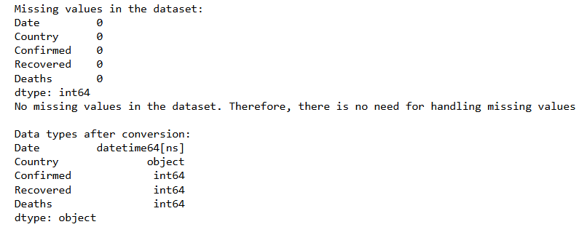
LOADING AND PREPROCESSING

Slide 4
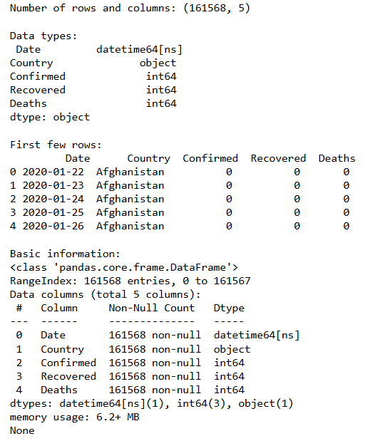
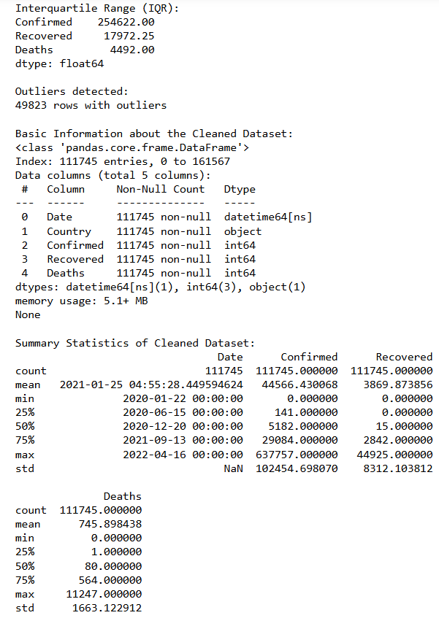
DATA EXPLORATION AND CLEANING

Slide 5
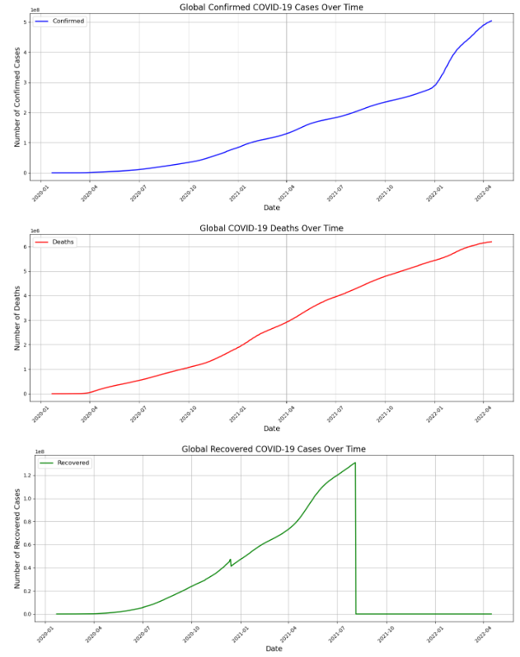
Q1) WHAT IS THE TREND OF CONFIRMED CASES, DEATHS, AND RECOVERIES GLOBALLY OVER TIME? DRAW PLOTS SEPARATELY.

Slide 6


Slide 7

Q2) WHICH COUNTRY HAS THE HIGHEST NUMBER OF CONFIRMED CASES, DEATHS, AND RECOVERIES AS OF THE LATEST DATE IN THE DATASET?

Slide 8
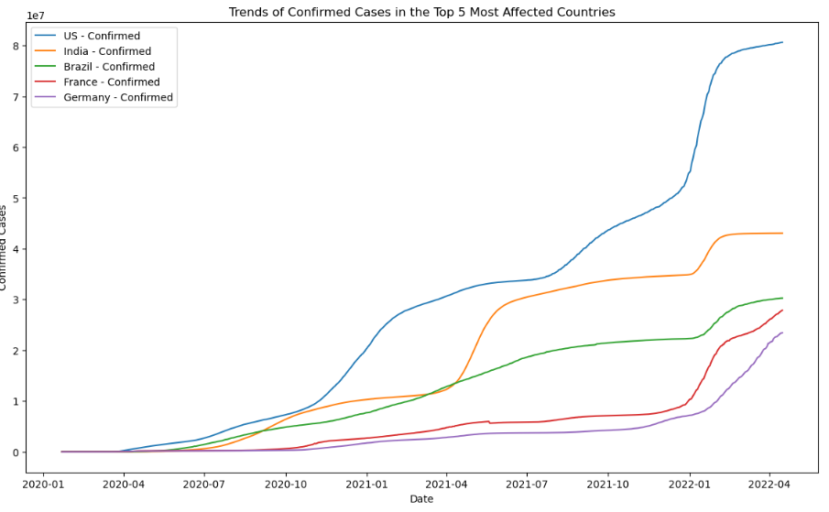
Q3) HOW DO THE TRENDS OF CONFIRMED CASES DIFFER BETWEEN THE TOP 5 MOST AFFECTED COUNTRIES?

Slide 9
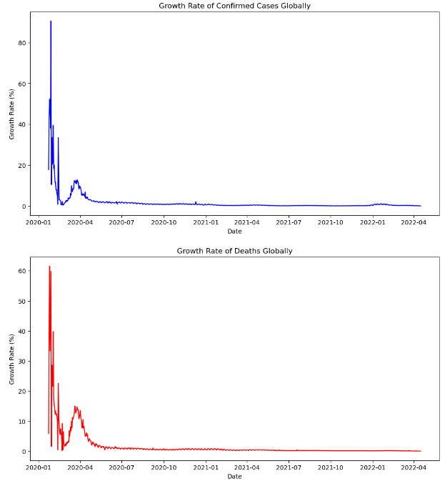
Q4) WHAT IS THE GROWTH RATE OF CONFIRMED CASES, DEATHS, AND RECOVERIES GLOBALLY?

Slide 10
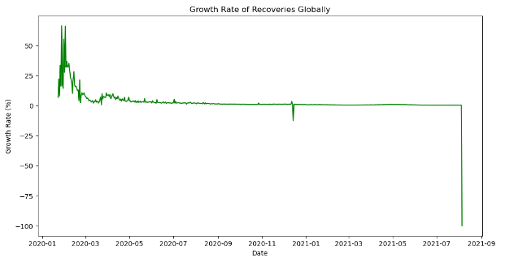

Slide 11
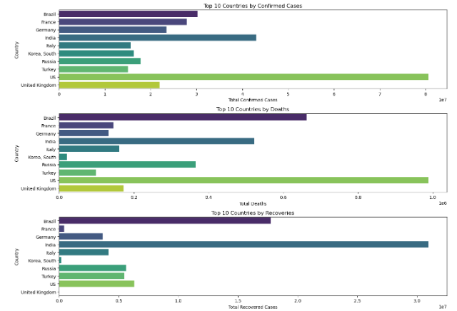
Q5) WHAT ARE THE CUMULATIVE CONFIRMED CASES, DEATHS, AND RECOVERIES FOR THE TOP 10 MOST AFFECTED COUNTRIES?

Slide 12
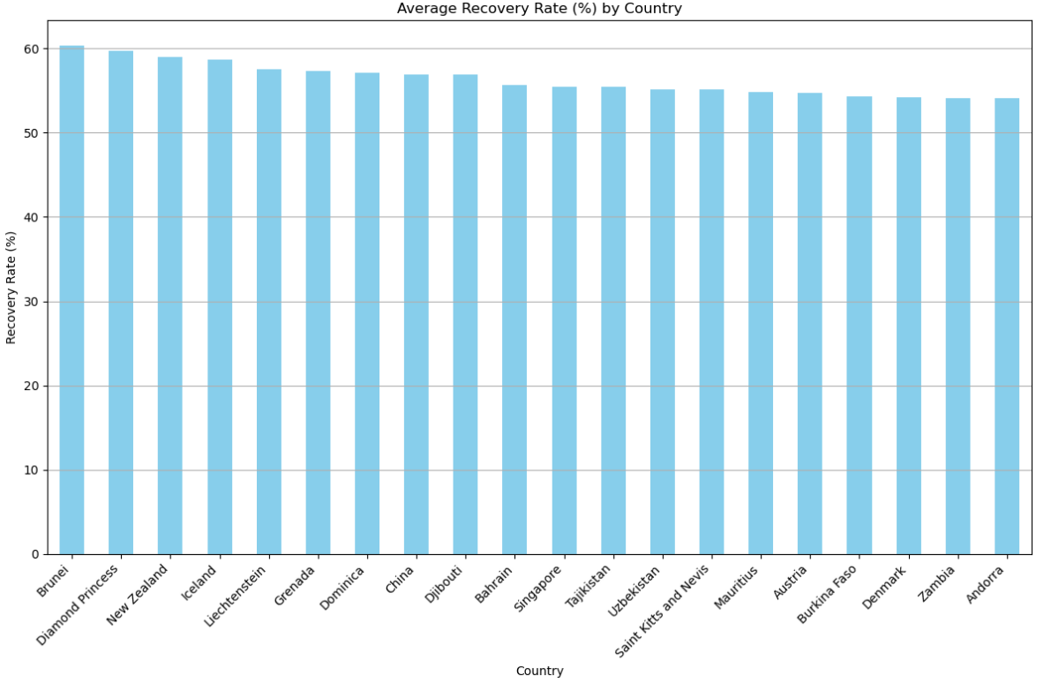
Q6) HOW DOES THE RECOVERY RATE COMPARE ACROSS DIFFERENT COUNTRIES?

Slide 13
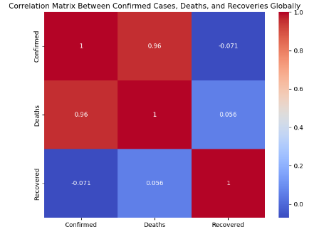
Q7) WHAT IS THE CORRELATION BETWEEN CONFIRMED CASES, DEATHS, AND RECOVERIES GLOBALLY?

Slide 14
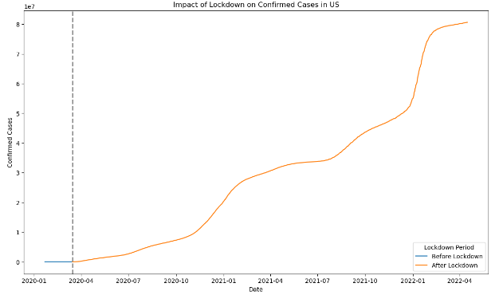
Q8) HOW DOES THE NUMBER OF TESTS CONDUCTED RELATE TO THE NUMBER OF CONFIRMED CASES IN VARIOUS COUNTRIES?

Slide 15
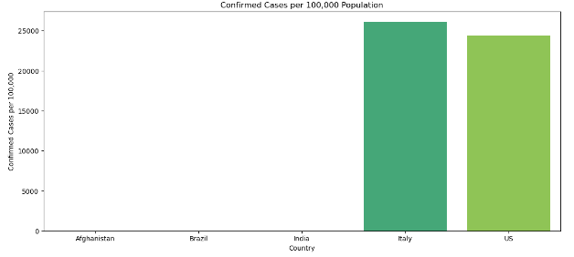
Q9) HOW DOES THE NUMBER OF TESTS CONDUCTED RELATE TO THE NUMBER OF CONFIRMED CASES IN
VARIOUS COUNTRIES?

Slide 16
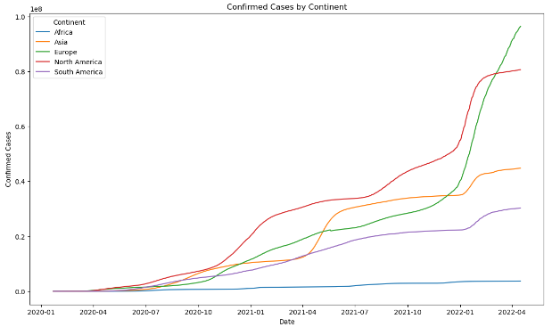
Q10) WHAT IS THE DISTRIBUTION OF CONFIRMED CASES, DEATHS, AND RECOVERIES BY CONTINENT?

Slide 17
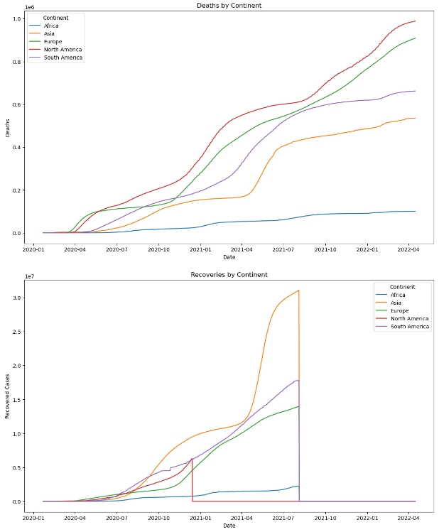

Slide 18
Thank
You

